Slide 1
Accenture
LOSS OF BRAND EQUITY ANALYSIS
RCH
Resea

Slide 2
LOSS OF BRAND EQUITY ANALYSIS
QUESTION
Do major outage events lead to a loss in brand equity? (Outage radiation loss)
TARGET
26 companies that witnessed major outages affecting a large number of their customers.
HOW DO WE ANSWER
Through sentiment analysis showing if the overall sentiment around the company/brand dropped significantly around outage dates, and if it did, when it bounced back to pre-incident levels.
METHODOLOGY
Extract articles from Factiva
Scraping the articles to obtain only the date, the title and the body.
Apply sentiment analysis (Python – library TextBlob ) to calculate the sentiment score
Weight the scores by the quantity of the articles = > impact coefficient
Aggregate the impact score by week
Smooth out short-term fluctuations and highlight longer-term trends using moving average
RESOURCES
Articles from one year window ( from 6 month before the incident to 6 month after the incident).

Slide 3
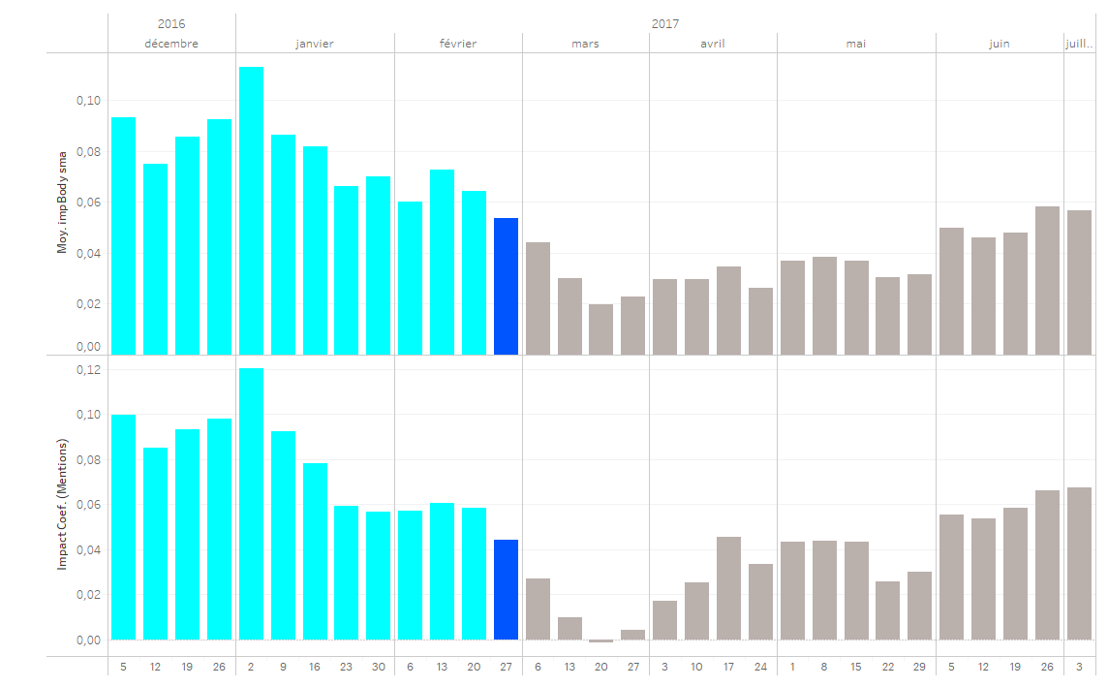
28-Febr-2016: 4-hour outage at Amazon's AWS CLOUD DIVISION

